Slide 1
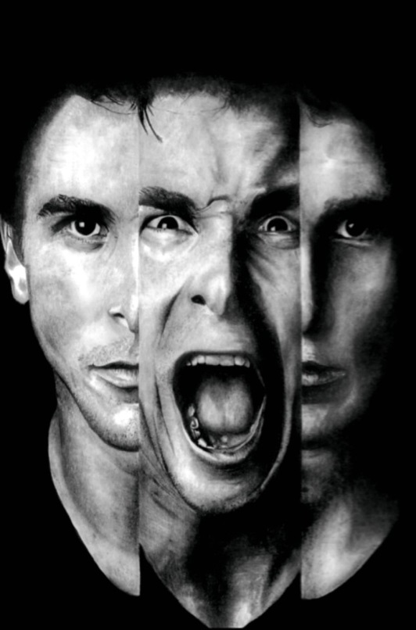
Schizophrenia

Slide 2
Outline
Syazwani
Introduction
Zatul
Diagnosis
Subtype
Farabi
Differential diagnosis
Course and Prognosis
History
Epidemiology
Etiology
Management
Clinical features and mental state examination

Slide 3
Outline
Introduction
History
Epidemiology
Etiology

Slide 4
Psychosis
Severe form of mental disorder
Greater severity of illness
Lack of insight
Inability to distinguish between subjective experience and reality (hallucinations & delusions)
Examples: organic mental disorders, schizophrenia and affective disorders

Slide 5
Psychotic Disorders
Schizophrenia spectrum disorders:
Brief Psychotic Disorder
Schizophreniform Disorder
Schizophrenia
Schizoaffective Disorder
Delusional Disorder
Psychoses due to General Medical Condition (Organic Psychoses)
Drug Induced Psychosis
Bipolar (Affective) Disorder
Major Depression with Psychotic Features

Slide 6
Overlap of Mood Disorders and Psychotic Disorders
Psychosis
Bipolar Disorder
Drug Induced
/ Organic
Psychoses
Depression w/ Psychotic Features
Bipolar Depression
Depression
Treatment- Resistant Depression
Notes:
Key Point: There is considerable symptomatic and syndromic overlap between different mood and psychotic disorders. Psychosis can be a manifestation of psychotic disorders (such as schizophrenia or schizophreniform disorder), associated with mood disorders, dementia, delirium and substance-induced disorders. Depression occurs in the course of bipolar disorder, but the majority of depression is unipolar. Depression may be resistant to treatment and some cases of treatment-resistant depression may be bipolar depression that has been misdiagnosed as unipolar. Therefore, it is important to understand the epidemiology and presentation of bipolar disorder and to screen for it.
6

Slide 7
Introduction
Common clinical syndrome
Profoundly disruptive psychopathology involving cognition, emotion, perception and other aspects of behavior
Effect of illness severe and long lasting
Both patients and families suffer poor care and social ostracism
Major burden of care

Slide 8
Outline
Introduction
History
Epidemiology
Etiology
19th century
Early Greek
Emil Kraepelin (1856-1926)
Eugene Blueler (1857-1939)
Schneiderian Criteria(1887-1967)

Slide 9
History
Early Greek
Described the delusion of grandeur ,paranoia , and deterioration in cognitive and personality
19th century
1856; Morel – demence precoce
Emil Kraepelin (1856-1926)
Groupings of illness
1868; Kahlbaum – katatonie
1879; Hecker – hebephrenie
Dementia praecox
Maniac depressive psychosis
Paranoia

Slide 10
Eugene Blueler (1857-1939)
Coined the term schizophrenia
Association
Schneiderian Criteria(1887-1967)
Need not to have deteriorating course
Autism
Ambivalence
Affective disturbances
THE FOUR As
First rank symptoms | Second rank symptoms
Audible thoughts Voices arguing or discussing or both Voices commenting Somatic passivity experiences Thought withdrawal or other experience of influenced thought Thought broadcasting Delusional perceptions All other experiences involving volition –made affects, made impulse | Other disorders of perception Sudden delusional ideas Perplexity Depressive and euphoric mood changes Feelings of emotional impoverishment

Slide 11
Outline
Introduction
History
Epidemiology
Etiology
Epidemiology
Gender and age
Reproductive factors
Medical illness
Infection and birth seasons
Substance abuse
Population density
Socioeconomic and cultural factors

Slide 12
Epidemiology
Worldwide | Malaysia
The Lifetime prevalence is 1% 1 in 100 Found in all societies and geographical areas Incidence and prevalence are roughly equal worldwide Incidence 0.5-5.0 per 10 000 | 100 000 - 500 000 Schizophrenia sufferers at any one time (could be underestimation!) Incidence rate 15.2 per 100 000

Slide 13
Epidemiology
Men | Women
15-25 More likely to be impaired by negative symptoms Poor outcome | 25-35( bimodal age distribution ) Better social functioning Better outcome
Gender And Age
Reproductive factor
No of children born to parent with schizophrenia is increasing
Infection and birth season
High risk : Winter and early spring
Gestational and birth complication exposure to influenza epidemic or maternal starvation during pregnancy ,rhesus factor incompatibility
10 times risk of developing schizophrenia in first degree relative
Fertility rate is close to general population
Differs in onset and course on illness
Equal for both sexes

Slide 14
Substance abuse
Prevalence >50%
Alcohol abuse – increased hospitalization risk, psychotic symptoms
Population density
Urban > rural
Socioeconomic and cultural factors
Economic
Hospitalization
Common street drugs- increased risk of SCZ
Nicotine ??
Heavy demand on hospital care as it is chronic
50% of all mental hospital beds
16% of all psychiatric patient who receive any treatment
Correlate with population more than 1 million
Social stressor
Good effect of nicotine | Bad effect of nicotine
Appears to improve cognitive impairment and Parkinsonism Decrease positive symptoms | Smoking associated mortality Decreased blood concentration of antipsychotic

Slide 15
Outline
Introduction
History
Epidemiology
Etiology
Etiology
Genetic factor
Biochemical factor
Others
Psychosocial factors
Neuropathology Neural circuit Brain metabolism Applied electrophysiology Eye movement dysfunction Psychoneuroimmunology Psychoneuroendocrinology

Slide 16
Etiology
No single factor is considered
Stress diathesis model is most often used
Stressor may be genetic, biological ,psychosocial

Slide 17
Model of the neurobiology
of schizophrenia
DNA, Gene
expression
Prenatal
infection
Complications
at birth
Nutrition
„First Hit“
Neurodevelopmental disturbance
Neurodevelopmental process
Altered anatomical-functional connectivity
Cognitive deficits
„Second Hit“
Genetics
Metabolism
Stress, Life Events
Acute psychosis
Neurodegenerative
process
„Third Hit“
Neurotoxic factors e.g. glutamate, immunological mechanisms
Deficit syndrome

Slide 18
Etiology
Genetic
factors
Biological factors
Psychosocial
factors
Others
Both single gene and polygenic theories had been proposed
Consanguinity
Higher in families
Higher in monozygotic twins
Prevalence of SCZ IN SPECIC POPULATION
1-1.5% for general population
10%-12% for 1st degree relatives
5-6% for second degree relatives
40 % for Child of two SCZ patients
12-15% Dizygotic twins
45-50 % Monozygotic twins
Adoption studies
Greater in biological parents than adoptees
MZ Twins had same concordance rate with twins reared together

Slide 19
Aetiology
Genetic
factors
Biological
factors
Psychosocial
factors
Others
Dopamine hypothesis
Other neurotransmitter
Serotonin
Norepinephrine
GABA
Neuropeptides
Glutamate
Acetylcholine and Nicotine
Excess dopaminergic activity within the mesolimbic-mesocortical systems (positive symptoms)
Decreased frontal dopamine activity (negative symptoms)
Supporting facts:
Efficacy and potency of anti-psychotic drugs
DRAs vs D2 receptors
Psychotogenic effect
cocaine and amphetamine increase dopaminergic activity
Opposing facts:
Does not elaborate whether is due to too much release of dopamine,too many receptor,hypersensitivity of dopamine receptor to dopamine
Do not specify which dopamine tract in the rain involved

Slide 20
Aetiology
Genetic
factors
Biological
Psychosocial
factors
Others
Dopamine hypothesis
Serotonin overactivity
Excess caused positive and negative symptoms in schizophrenia
Serotonin antagonist activity of clozapine to decrease positive symptoms in chronic patients
Other neurotransmitter
Selective neuronal degeneration of Norepinephrine
Loss of GABAergic neurons in hippocampus
Alteration of Neuropeptides
Hyperactivity,hypoactivity, and Glutamate induced neurotoxicity
Decreased muscarinic and nicotinic receptor

Slide 21
Aetiology
Genetic
factors
Biological
factors
Psychosocial
factors
Others
Theories about individual patients
Psychoanalytic theories
Psychodynamic theories
Learning theories
Theories about the family
Double bind
Schisms and skewed families
Pseudomutual and pseudohostile
Expressed emotion

Slide 22
Psychosocial and Psychoanalytic theories
Psychoanalytic theories
Learning theories
Various symptoms of schizophrenia have symbolic meaning for individual patient
Eg: patient may have become grandiose after an injury to the self-esteem
Sigmund Freud
Margaret Mahler
Paul Federn
Harry Stack Sullivan
Children who later have schizophrenia learn irrational reaction and ways of thinking by imitating parents who have significant emotional problem
Poor model for learning during childhood
Notes:
Sigmund Freud Developmental fixation that occurred earlier than those culminating in the development neuroses
Defect in ego development Defect in ego development Intrapsychic conflict arise from early fixation and ego defect
Intrapsychic conflict arise from early fixation and ego defect
Intrapsychic conflict arise from early fixation and ego defect

Slide 23
Psychosocial and Psychoanalytic theories
Some SCZ pt come from dysfunctional familes
Not to overlook pathological family behavior that can increase emotional stress

Slide 24
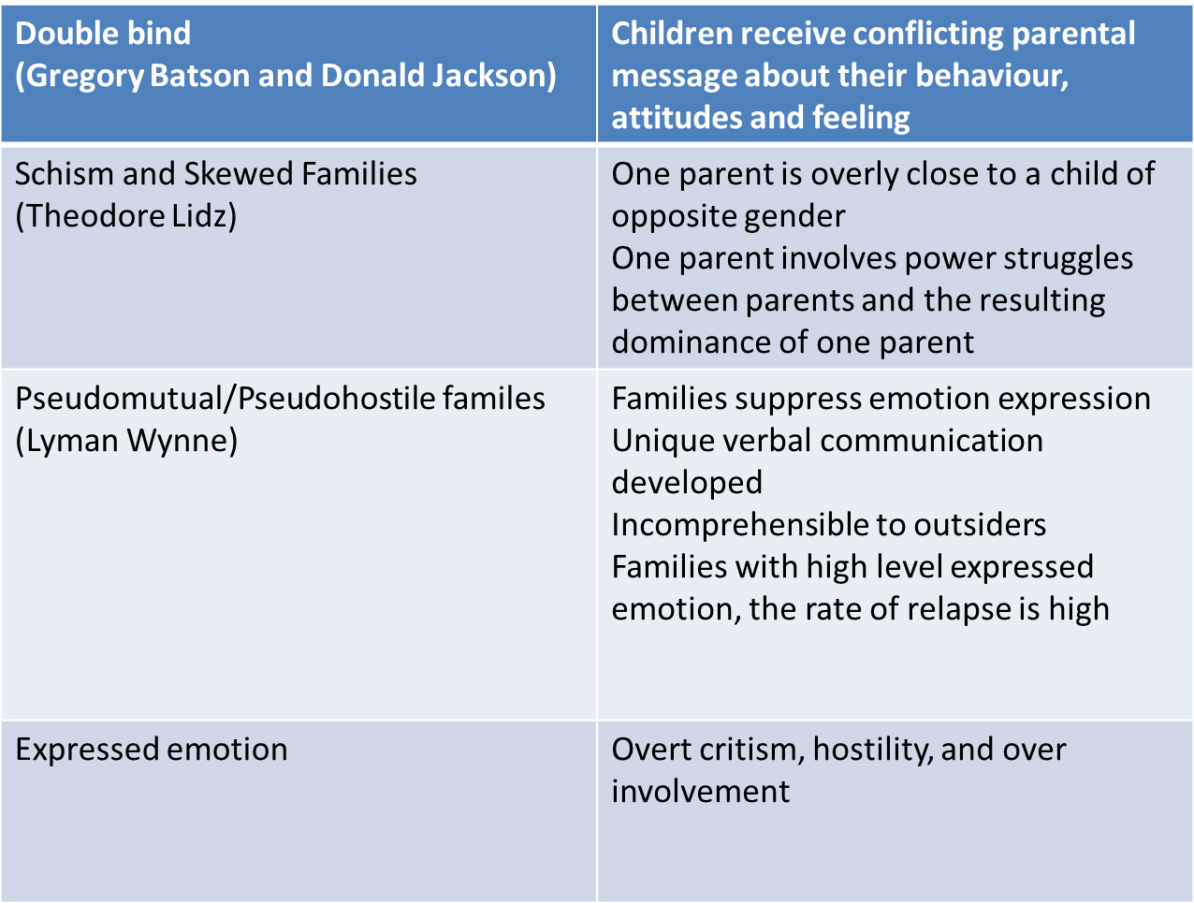

Slide 25
Aetiology
Genetic
factors
Biological
factors
Psychosocial
factors
Others
Neuropathology
Neural circuit
Brain metabolism
Applied electrophysiology
Eye movement dysfunction
Psychoneuroimmunology
Psychoneuroendocrinology

Slide 26
Reference
Kaplan & Saddock Sypnosis of Psychiatry, 10th edition,2007
Kaplan & Saddock Handbook of Psychiatry, 2010

